Slide 1

Debugging

Slide 2
What is Debugging?
Debugging is the process of finding bugs in code
A software bug is an error or failure in a computer program
Where did the term bug come from?
Grace Hopper coined the term ‘bug’ when a moth short-circuited a computer in 1945

Slide 3
Why Should You Debug?
The ability to debug code and use debug tools is critical in becoming a successful software developer
Any time you come across an issue (i.e. bug, error) in your code, your first instinct must be to place a breakpoint and begin stepping through your code to debug the issue
While the application is in debug mode, you can hover over variables, fields, properties, etc. to see the values change as you step through.

Slide 4
Breakpoint
Drop a breakpoint on a line of code to halt the program when that line is executed
Hover mouse pointer over a variable or object to see the values stored in that variable or object
Breakpoint window shows information about all of the breakpoints in your application as well as allows the ability to enable/disable them

Slide 5
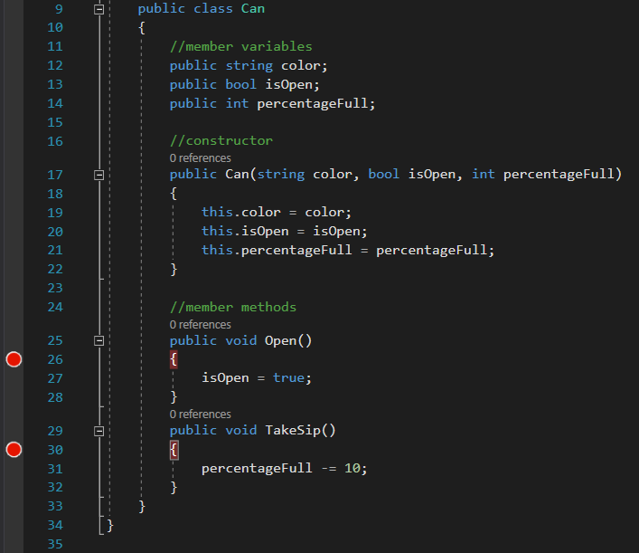
Breakpoint

Slide 6
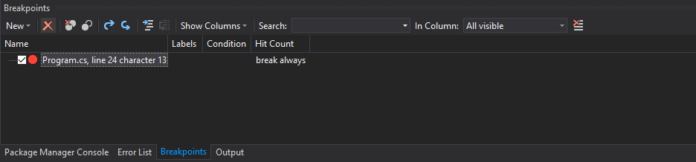
Breakpoint Window
Allows a developer to see all of the breakpoints in an application
In Visual Studio 2017: Menu Bar → Debug → Windows → Breakpoints

Slide 7
Stepping with Breakpoint
Step Over (F10)
Step over a method call without having to step through each individual line of code inside the method. This typically happens when you know code works.
Step Into (F11)
Step into a method call to step through the code block located inside the method
Step Out (Shift + F11)
Step out a block of code after you have already stepped into it.
Continue
Set up strategic breakpoints and continue past clean code to come across a bug quicker

Slide 8
